Slide 1


Lecture 5
Programming Parallel Computers
Lectures: Prof. Janusz Kowalik
Laboratory :
Mgr.Tadeusz Puzniakowski
University of Gdansk
October 7-25 , 2013

Slide 2
Part 5
MPI Example :numerical integration
Global and local variables
Point to point communication
Collective communication is more efficient
than equivalent repetition of point-to –point
Broadcast
Gather
AllGather
Scatter
Reduce

Slide 3
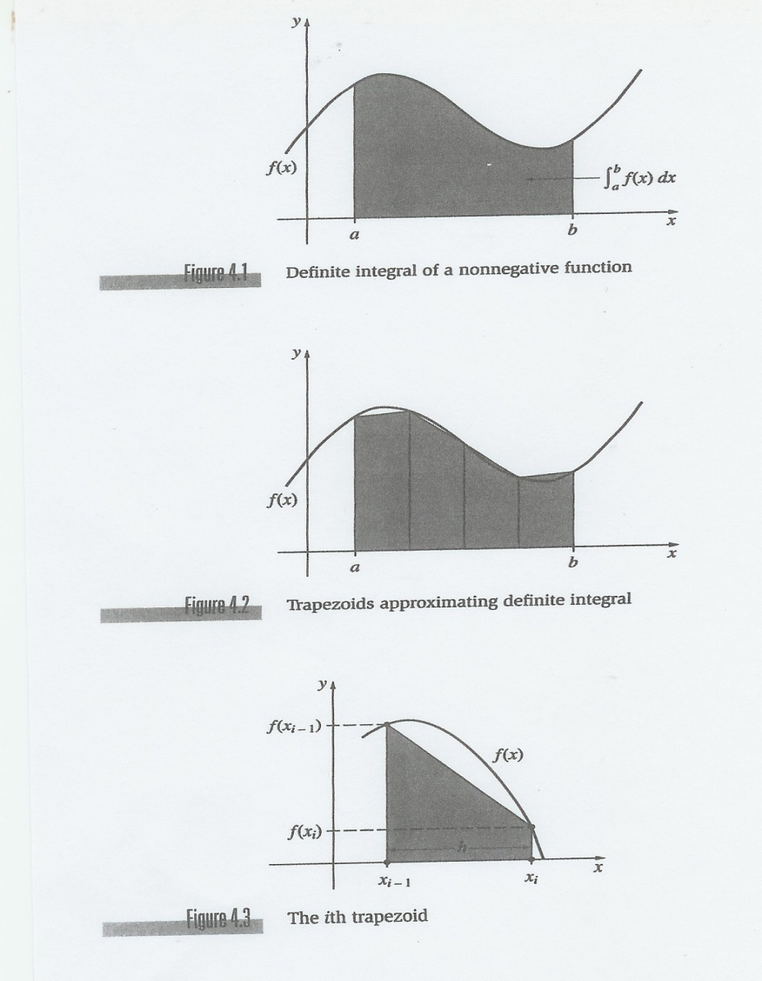

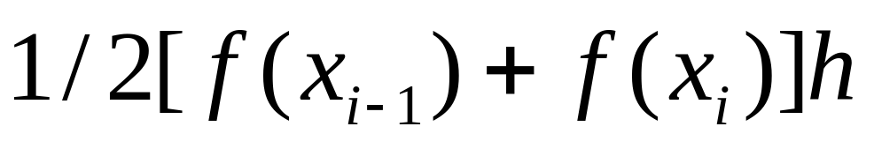
An Application : Numerical Integration
We assume that all function
values are positive.
The base of every trapezoid
approximating the area under
the function is fixed
h=(b-a)/n
The trapezoid area is:
The entire approximation is:

Slide 4
Serial program
We can now write a serial program for integrating the function f(x) from a to b. given the number of intervals n and the length of each trapezoid
h=(b-a)/n.
This will be a float function Trap :
float Trap( float a, float b, int n)

Slide 5
Serial program integrating f(x)
float Trap(float a, float b, int n) {
float integral,h,x;
float f(float);
h=(b-a)/n;
integral=(f(a)+f(b))/2.0;
for(int i=1;i<=n-1;i++) {
x=x+h;
integral=integral +f(x);
}
integral=integral*h;
}
/* end of Trap*/

Slide 6
Parallel program
Parallelizing the Trapezoidal Rule
The assumption: the number of intervals n is divisible by p the number of processes.
n/p = k (integer).
Parallel algorithm
1. Each process gets and computes k=n/p trapezoids.Serially!
2. Then all partial results are added.
Reduction .

Slide 7
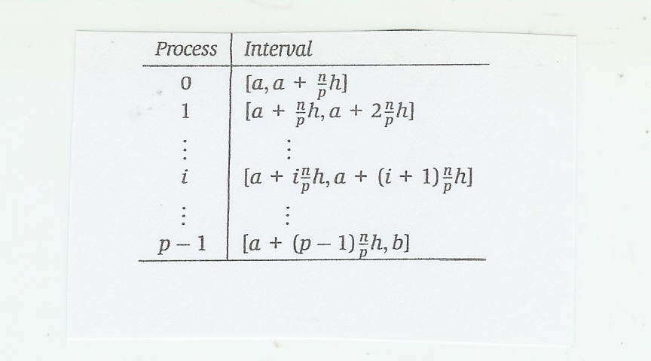
Assignment of intervals to processes
i is the rank of a process
Each process will calculate areas of n/p trapezoids.
Every trapezoid will have the base size h .

Slide 8
Parallel Trapezoidal rule.
In the parallel program we need to calculate the left and the right ends of the integration intervals.
k=local_n=n/p (the value of h is fixed)
Let us call the interval ends local_a , local_b.
local_a=a+my_rank*local_n*h;
local_b=local_a+local_n*h;

Slide 9
Assigning intervals to processes
local_n=n/p
local_a=a+my_rank*local_n*h;
local_b=local_a+local_n*h;
i=my_rank

Slide 10
continuing
In the parallel program we will call Trap:
local_a=a+my_rank*local_n*h;
local_b=local_a+local_n*h;
Trap (local_a, local_b, local_n);
The total integral is the sum of integrals calculated by all processes.
This can be accomplished by using process 0 to collect all values from other processes.

Slide 11
Collecting partial values
if (my_rank==0) {
total=integral; /* its own computed value*/
for (source=1; source<p ; source++) {
MPI_Recv( &integral, 1 , MPI_FLOAT,source, tag,
MPI*COMM_WORLD);
total=total + integral;
}
} else {
MPI_Send (&integral,1,MPI_FLOAT, 0, tag,
MPI_COMM_WORLD);
}
if (my_rank==0) print the result;
MPI_Finalize( );
Send and Receive statements are in a loop!!
dest=0

Slide 12
Discussion
The function integration program is an example of a combination of the map pattern followed by the reduction pattern.
The map pattern is the SPMD type.
The reduction is the addition of
partial results.

Slide 13
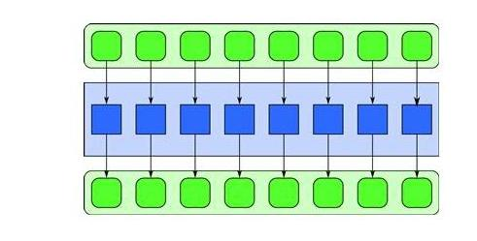
Map
In map some function is applied to a data
collection and produces another collection .

Slide 14
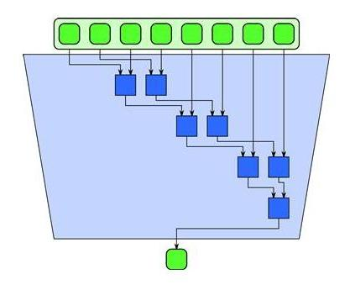
Reduction
The common application is
adding partial results.

Slide 15
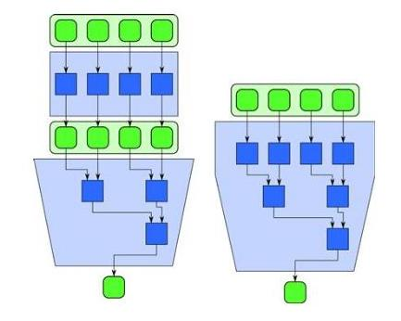
Map and reduction fused
A map followed by a reduce can be optimized by fusing the map computations with the initial stages of a tree-oriented reduce computation.
The optimized fusion method
avoids synchronization afterthe map and writing the map results to the memory. More efficient.
Integrating a function=
map +reduction.

Slide 16
Variables
All variables in a process are local to this process. There is no concept of shared memory.
However, some variables are global with the same value for all processes.

Slide 17
Global and local variables.
(i) Thi parallel program Trap uses the SPMD paradigm.
Process 0 may be different from all others but it still runs the same program.
(ii) We are careful distinguishing global variables that are significant on all the processes from local variables whose values are significant only on individual processes.
They should be named distinctly.

Slide 18
Global and local variables
If we write:
if(my_rank==2) local_a=4;
then local_a is local in the memory of process 2. No other processes are impacted.
If we write
a=4 ;
this variable a will be global on all processes.
It is very important to call them differently!! They are not named and declared differently.

Slide 19
Global and local variables
float a=10;
mya=a*myrank;
print mya ;
Every process has variable a and compute its own mya.
But a can be only changed globally
In the code.
Not by any process.

Slide 20
Collective communication I
A communication pattern that involves all processes is called the collective communication.
For example, MPI_Bcast ,,.
The broadcast syntax is:
MPI_Bcast(
Message,
Count,
Datatype,
Root, (from where)
communicator)
arguments

Slide 21
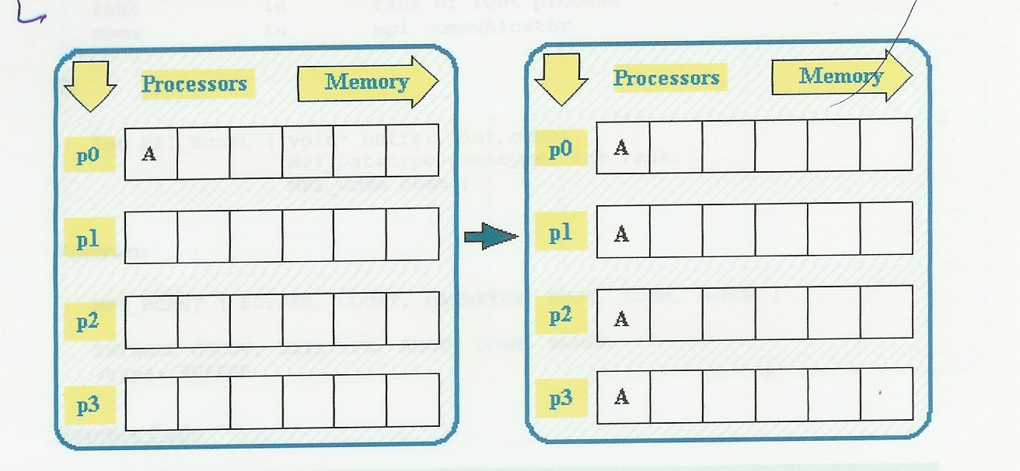
Broadcast II
Broadcast from the root process 0 to all

Slide 22
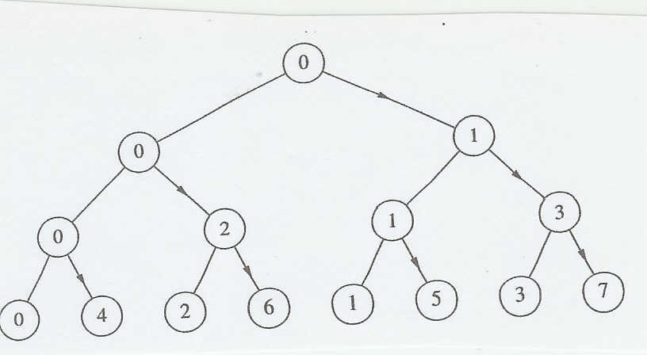
Tree configuration for broadcast III
In the broadcast the root sends the same message
to all processes.
If the processes are configured as a tree
the broadcast takes only logp steps
if p is the number processes.

Slide 23
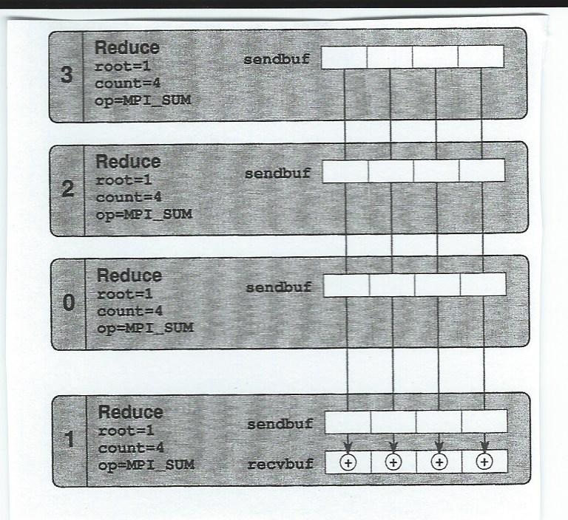
Reduction
Summation reduction

Slide 24
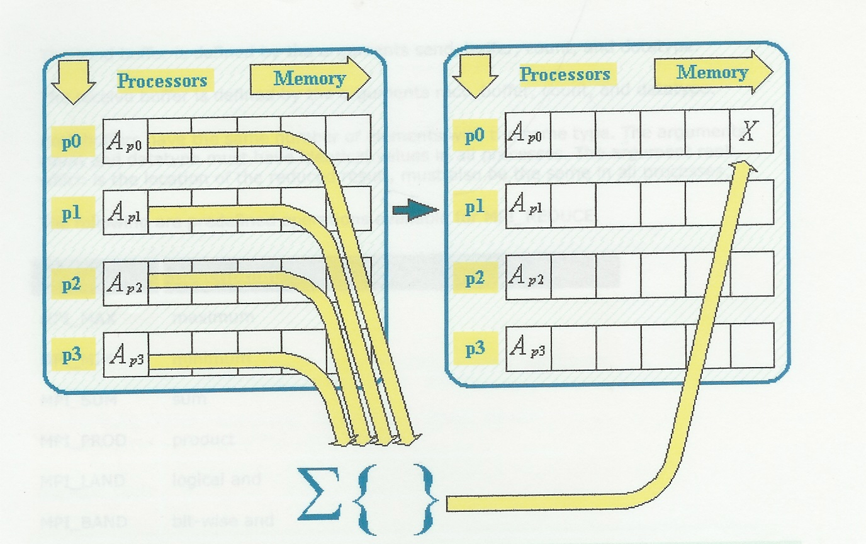
Reduction V
Adding reduction
root

Slide 25
Reduction VI
In reduction operations processes perform
Global binary operations;
Maximum, minimum, sum etc.
The MPI_Reduce syntax is:
MPI_Reduce(&operand, result,
datatype,operation, root,communicator)
Example:
MPI_Reduce(& Integral,total,MPI_FLOAT,
MPI_SUM, 0, MPI_COMM_WORLD);
root=target destination

Slide 26
Reduce Example
We wish to add all partial results called integral and have the sum called total.
The root ( process destinastion) is process 0.Put the result called total to process 0 memory.
MPI_Reduce(&integral,total,MPI_FLOAT,
MPI_SUM, 0, MPI_COMM_WORLD);

Slide 27
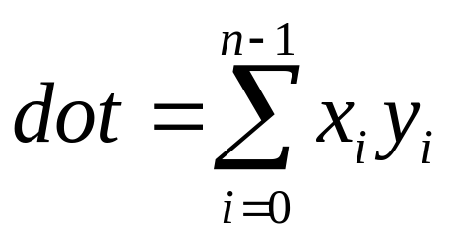
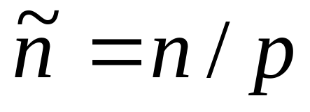
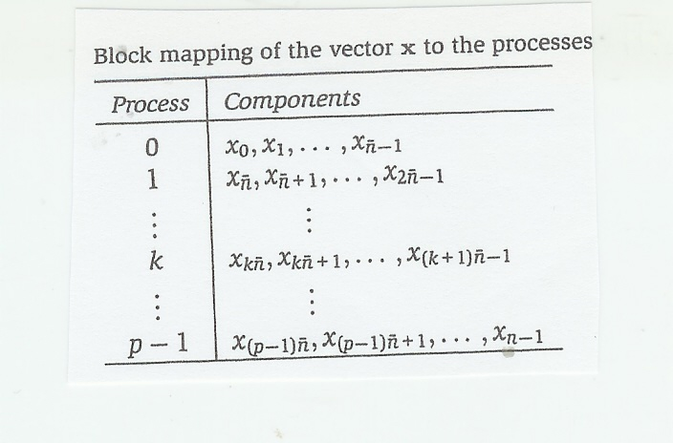
Dot product VII
Definition:
Two vectors x,y of the
length n,
Assume that n is divisible by p and

Slide 28
SPMD in linear algebra
1) Saxpy
z=ax+y
Most common math operations are parallel
SPMD operations
2) Matrix /vector product
z=Ax
3) Dot product of two vectors
a=xy

Slide 29
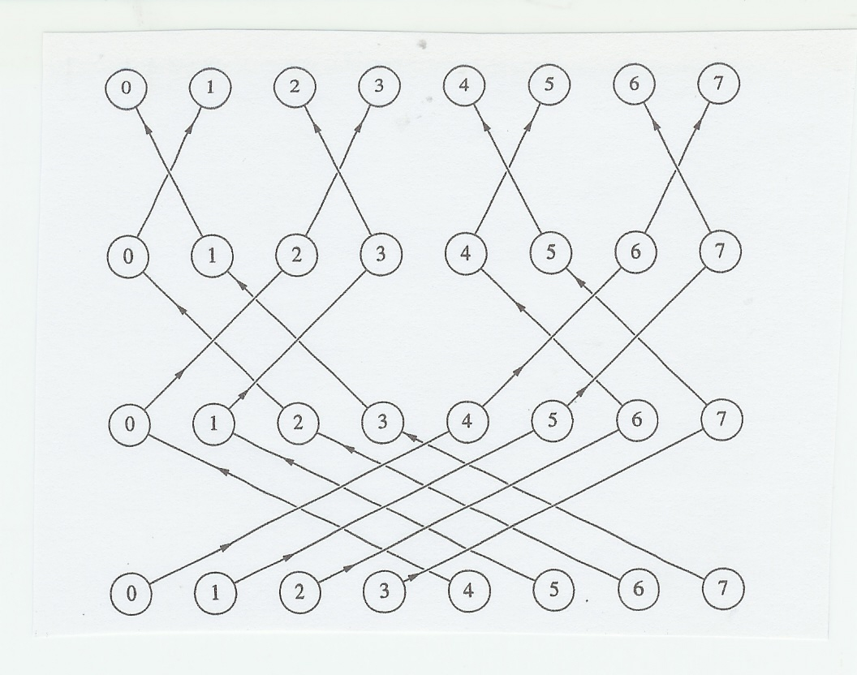
AllReduce VIII
The Butterfly
pattern of
accomplishing
Allreduce
equivalent to
Reduce
followed
by Broadcast
After log n steps all processes
contain the total result.

Slide 30
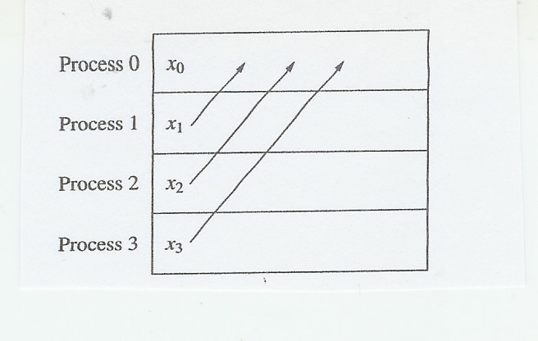
Gather IX
MPI_Gather collects the data referenced by send_data
from each process and stores the data
in process rank order
with rank root in the memory referenced by recv_data.

Slide 31
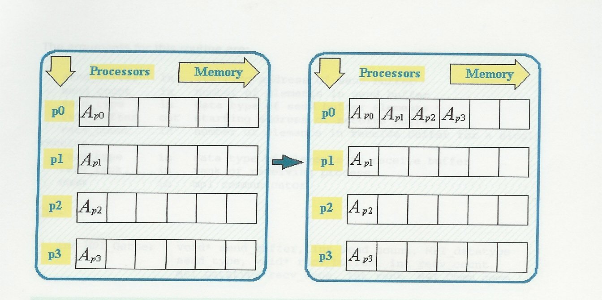
Gather X
Notice the rank order of arranging
gathered data

Slide 32
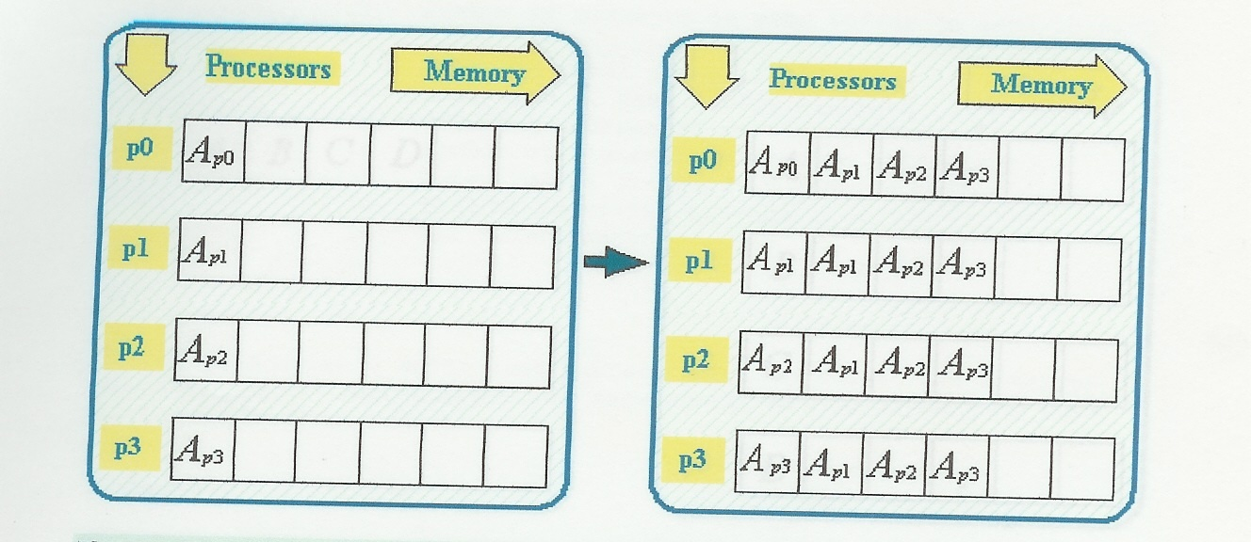
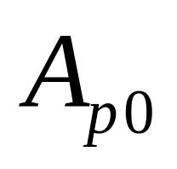
AllGather XI
The first element is

Slide 33
AllGather XII
The butterfly scheme can be used for AllGather .
Allgather is an efficient function. It is superior to the repeated use of Gather.
In general:
Collective functions are more efficient than repeated
point-to-point functions accomplishing the same result.

Slide 34
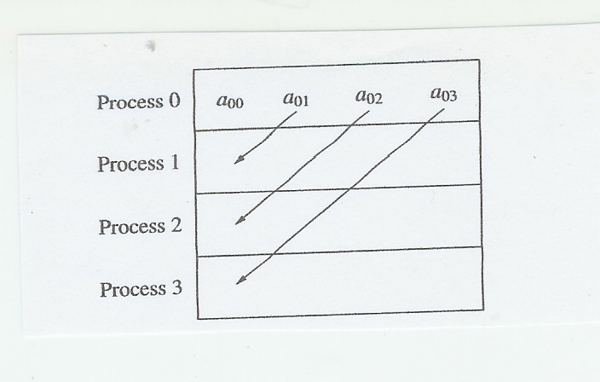
Scatter XIII
Scatter is
the reverse
operation
to Gather.

Slide 35
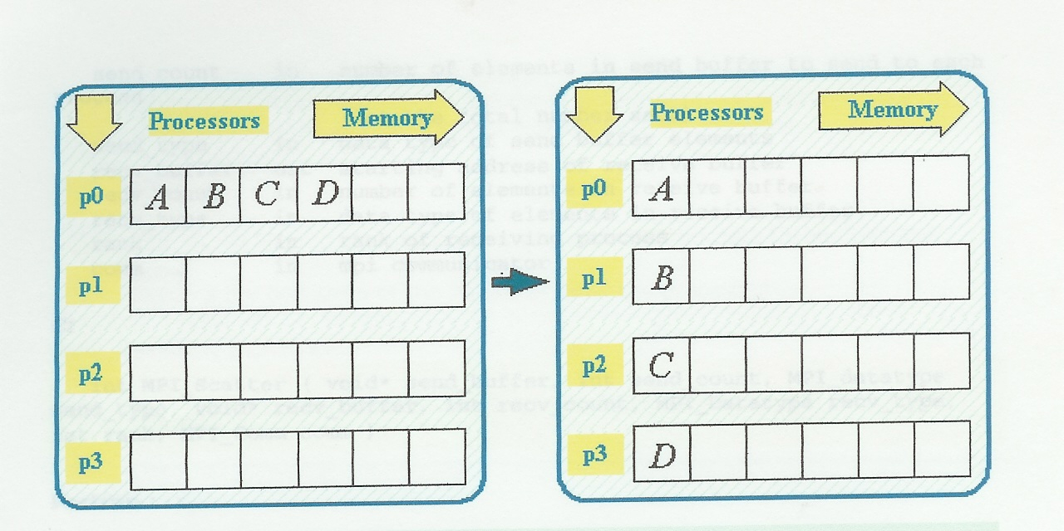
Scatter XIV

Slide 36
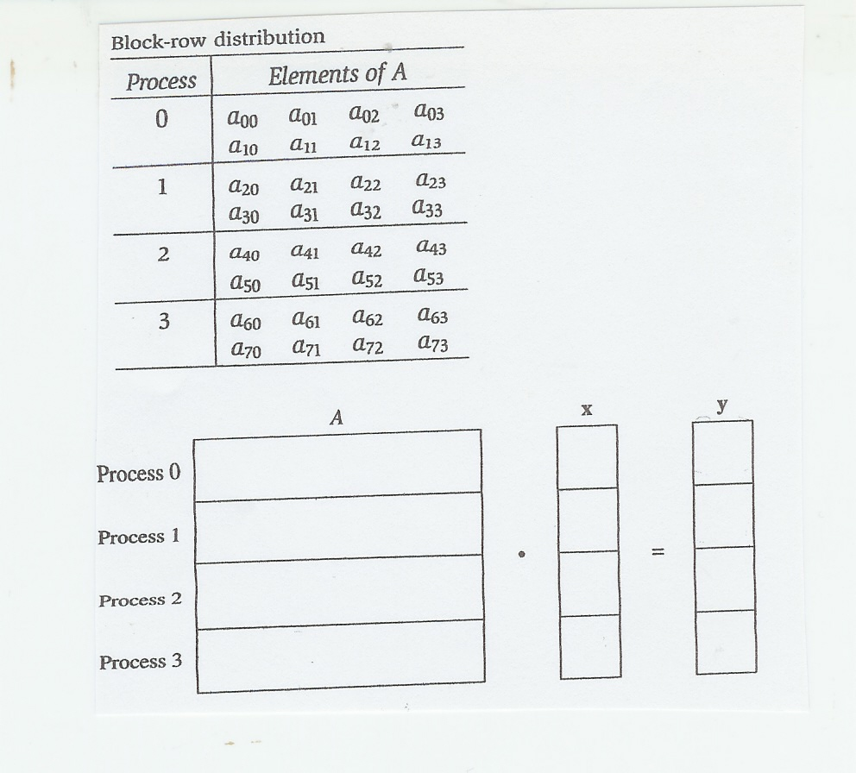
An example of Scatter and Gather XV.
Suppose we want
to design a parallel
code for matrix/vector
multiplication.
x is a given vector
and y is the result
vector. Ax=y
The matrix has been
block-row
decomposed.
Each process will
get n/p rows of A
and x
n=8
p=4
n/p=2
The distribution of rows can be done by Scatter,
and collecting partial results by Gather.

Slide 37
A Scatter code XVI
MPI_Scatter (&(local_A[0][0]),n/p,
MPI_FLOAT, row_segment, n/p,
MPI_FLOAT, 0,MPI_COMM_WORLD);
We assume that n/p is an integer.
In our case n/p=2
Row segment (strip) will be defined in the next lecture.

Slide 38
Nonblocking communication
Point-to-point communication can be performed with nonblocking semantics .
A nonblocking point-to-point call merely initiates a message transmission and returns very quickly to the user code.
In an efficient implementation, waiting for data to arrive and the actual data transfer occur in the background, leaving resources free
.

Slide 39
continued
Non-blocking communication
provides an obvious way to overlap communication, i.e., overhead, with useful work. The possible performance advantage, however, depends on many factors, and may even be nonexistent .

Slide 40
Summary
The MPI collective instructions are efficiently implemented and have better performance than repeated Send and Receive instructions.
Due to their computational efficiency collective communications are preferred over
repeated Send and Receive.
The function MPI_Reduce is very useful in many mathematical programs.
Similar construct reduce is used also in
OpenMP.

Slide 41
Key terms
Point-to-point communication
Collective communication
Gather
AllGather
Scatter
Reduce
Binary operation
Trapezoidal rule for integration
Root-target destination or source

